Slide 1
Condition Variable
08/07/2021

Slide 2
General Info
notify_one and notify_all (for when one thread is working while the others are sleeping or waiting)
The others were waiting for some condition variable
To synchronise threads, we need a common condition variable
If the condition returns false, the thread 1 waits BY releasing the mutex (to thread 2 who was waiting for it and will notify 1 when done)
If the condition returns true, the thread 1 can continue with the rest of the function

Slide 3
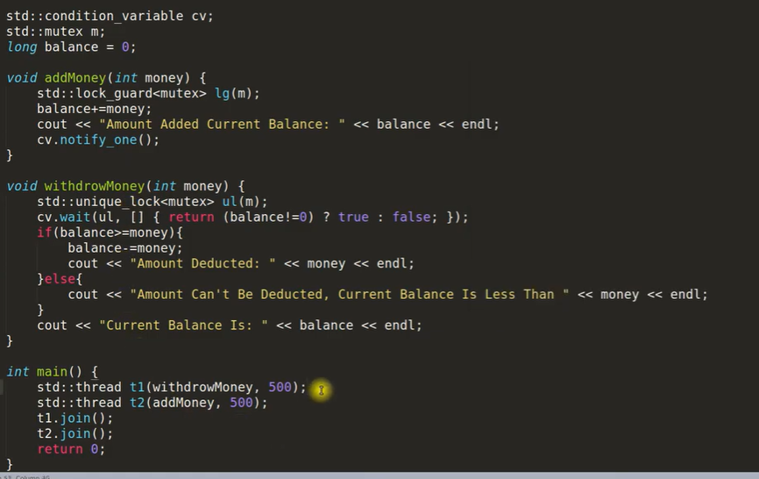
Code Example for Syntax

Slide 4
Notes
You need a mutex to wait on the condition:
If a thread wants to wait on a condition:
Acquire the mutex lock
Execute the wait (wait, wait_for, wait_until) → Automatically releases the mutex if wait condition is not true (for wait_for or until, look at those notes)
When cv is notified, thread is awakened and auto gets the mutex lock ownership. The thread still checks the condition (it could be a false alarm) and moves on

